Slide 1

Multiple imputation: a miracle cure for missing data?
Katherine Lee
Murdoch Children’s Research Institute & University of Melbourne

Slide 2
Missing data in epidemiology & clinical research
Widespread problem, especially in long-term follow-up studies
Clinical trials with repeated outcome measurement
Longitudinal cohort studies (major focus)
Default approach omits any case that has a missing value (on any variable used in the analysis) – “Complete case analysis”
Notes:
Participants can miss a visit or can drop out altogether
Particularly pertinent as studies become larger and longer
more chance for loss to follow-up
more variables that can have missing data

Slide 3
Consequences of missing data
Can introduce bias
Those with complete data may differ from those with incomplete data (responders may differ from non-responders)
Estimation based on complete cases only may give biased estimate of population quantity of interest
Loss of precision / power
Missing data reduces sample size
In particular, missing covariate data may greatly reduce sample size
Notes:
Bias
For example it is often those with poorer outcomes who don’t come back
Loss of precision
– particularly if lots of variables in an analysis e.g. a multivariable model, each variable may only be missing in a few participants but if we restrict the analysis to only participants with data on all variables in the analysis it can mean loosing large numbers of participants.

Slide 4
Why are the data missing?
An analysis with missing data must make an assumption about why data are missing
Three assumptions (within Rubin’s framework) for the ‘distribution of missingness’.
Missing completely at random (MCAR): probability of data being missing does NOT depend on the values of the observed or missing data
Missing at random (MAR): Probability of data being missing does NOT depend on the values of the missing data, conditional on the observed data
Missing not at random (MNAR): Probability of data being missing depends on the values of the missing data, even conditional on the observed data
Complete case analysis unbiased if data are MCAR
Notes:
MCAR – very restrictive and unlikely to be true in practice.
MAR – once we condition on the observed values, no difference between participants with observed and missing data. Less restrictive, but still may not be true
MNAR – can’t know whether data are MNAR by definition

Slide 5
Overview of talk
Motivating example
Brief introduction to multiple imputation (MI)
The appeal and limitations of MI
Our research at the MCRI:
Is MI worth considering?
How should MI be carried out?
Which imputation procedure to use?
Imputation of non-normal data
Imputation of limited range variables
Imputation of semi-continuous variables
Some unanswered questions
How should MI and final results be checked?
Diagnostics for imputation models
Sensitivity analysis
Summary

Slide 6
An example: The Victorian Adolescent Health Cohort Study (VAHCS)
Aimed to study
development of adolescent behaviours & mental health and their interrelationships
“continuity of risk” and adult “life outcomes”
Representative school-based sample (n=1943)
Adolescent phase: 6 waves of frequent (6-monthly) follow-up
Adult phase: 4 waves at 3-6 year intervals
Overall retention good but wave missingness
E.g. Only 30% of cohort had complete data for waves 1-6
Missingness in both outcomes (later waves) and covariates (earlier waves)
Data missing for many reasons (mostly unknown!)
Notes:
Study lead at the RCH
Representative sample of young Victorians.
44 schools randomly selected throughout Victoria, stratified by region and school type.
Also collected adult data.
Survey administration was by laptop computer - allowed branched questions in an interview style format and increased the sense of confidentiality.
Overall retention generally good but people often missed a wave – non-monotone missingness

Slide 7
Multiple imputation (MI)
Two-stage approach:
Create m (≥ 2) imputed datasets with each missing value filled in using a statistical model based on the observed data
Principle: Draw imputed values from the predictive distribution of the missing data Z^{mis} given the observed data Z^{obs}, i.e. p(Z^{mis} | Z^{obs}, X)
“Proper” imputation must reflect uncertainty in the missing values
Notes:
Multiple imputation is an alternative way to handle the missing data…

Slide 8
Multiple imputation (MI)
Analyse each imputed (complete) dataset using standard (complete case) methods, and combine the results in appropriate way (Rubin’s rules)…
Overall estimate = average of m separate estimates
Variance/Standard Error: combines within and between imputation variance…
Two stages separable in practice but integrally related: emphasis should be on overall analysis (of incomplete data), NOT on “filling in” the missing values.
Notes:
Multiple imputation is an alternative way to handle the missing data…

Slide 9
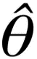
INCOMPLETE
DATASET
IMPUTE MISSING
DATA MULTIPLE
TIMES
ANALYSE EACH DATASET & ESTIMATE THE PARAMETER OF INTEREST
COMBINE
RESULTS
1
1
Variables
Participants
2
θ
2
MI
. . .
. . .
m
m
* Diagram courtesy of Cattram Nguyen

Slide 10
Rubin’s rules
Let the k^{th} completed-data estimate of θ be with (estimated) variance V_{k} , then:
Define within- and between-imputation components of variance as:
Then the estimated variance of is:

Slide 11
The appeal of MI
Allows data analyst to use standard methods of analysis for complete datasets
Any analysis method that produces an estimate with approximate normal sampling distribution
Many analyses may be performed with same set of imputed data
Software readily solves challenge of managing multiple datasets
Valid if data are MCAR or MAR
Just need to be confident re the MAR assumption, imputation modelling, etc…
Notes:
Can be used with the majority of the most common methods of analysis.
A lot more applicable than complete case analysis

Slide 12
Proliferation
Review of articles published in 2009-2013 in Lancet and New England Journal of Medicine that used MI
(Rezvan, Lee & Simpson, BMC Med Res Methodol, 2015)

Slide 13
Limitations of MI
“MI” is not well-defined: different approaches can lead to different results
Decisions made when setting up the imputation model can affect the results obtained
It is not clear that results are always better than potential alternatives
Users can go astray if they think of MI in terms of “recovering” the missing data

Slide 14
Some important questions for MI in practice
Is MI worth considering?
Is it likely to correct bias or increase precision for estimates that address question[s] of interest?
How should MI be carried out?
Imputation model specification: how should I perform my imputations?
How should MI and final results be checked?
Diagnosing poor imputation models?
Sensitivity analysis?
Notes:
Don’t talk through black bits…
These are the question that we have focussed on within our research in Melbourne.
Will take each in turn and talk about what we research we have conducted in Melbourne and our future areas of research…

Slide 15
Our research
Is MI worth considering?
Are there potential auxiliary variables that can be used to predict the missing values?
Often little to gain from MI when missing data in the exposure or outcome of interest (unless there is strong auxiliary information)
MI can introduce bias not present in a complete case analysis if use a poorly fitting imputation model
Much greater potential for gains when there is a fully observed exposure and outcome of interest, but missing data in variables required for adjustment
Can recover cases with information on the question of interest
(White & Carlin, Stat Med, 2010; Lee & Carlin, Emerg Themes Epidemiol, 2012)
Notes:
By auxiliary info I mean variables in the dataset that are not in the imputation model but that can be used to predict the missing values
MI may be valuable for some analyses but not others.
Means that the same set of imputations may be “good” for some purposes but not others
Cuts across one attraction of the MI paradigm that one set of imputations can be used for all analyses

Slide 16
Our research
How should MI be carried out?
Which imputation procedure to use?
How to impute non-normal variables?
How to impute limited range variables?
How to impute semi-continuous variables?
How to impute composite variables?
How to select auxiliary variables?
How to apply MI in large-scale, longitudinal studies?
…
Notes:
There are a number of questions within this
This is by no means an exhaustive list but it what we have and will be focusing on

Slide 17


1. Which imputation procedure to use?
For practical purposes, choice between:
Multivariate normal imputation (MVNI): Assumes all variables in the imputation model have joint MVN dist’n
Has a theoretical justification
Is it valid for imputing binary and categorical variables?
Cannot incorporate interactions/non-linear terms
“Chained Equations”(MICE): Uses a separate univariate regression model for each variable to be imputed
Very flexible
Lacks theoretical justification
Managing in large datasets can be challenging
Risk of incompatible distributions?
Notes:
Flexible – can tailor imputation models to the variable of interest e.g. logistic regression for binary, ordinal logistic regression for ordinal
Incompatible distributions - not clear how important this is

Slide 18
1. Which imputation procedure to use?
VAHCS case study - “Cannabis and progression to other substance use in young adults: findings from a 13-year prospective population-based study” (Swift et al, JECH, 2011)
Sensitivity analysis (Romaniuk, Patton & Carlin, AJE, 2014)
Examined a selection of results, across 15 approaches to handling missing data (12 using MI)
For example: estimating prevalence of amphetamine use stratified by concurrent level of cannabis use (wave 9)…
Notes:
MI methods varied in:
Choice of imputation method
Inclusion of auxiliary variables
Inclusion/omission of cases with excessive missing data
Different approaches for imputing highly skewed continuous distributions

Slide 19
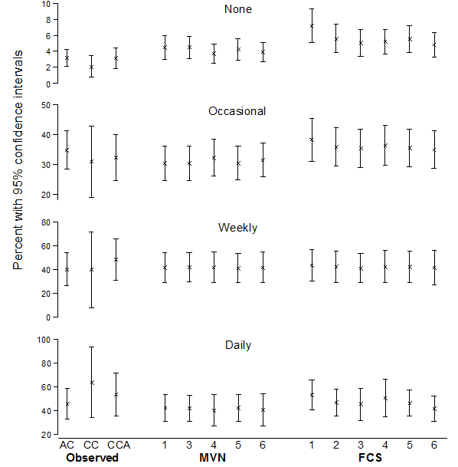
Prevalence of amphetamine use in young adults
MVNI
MICE
Notes:
Y-axis = prevalence of amphetamine use in the 4 different categories of cannabis use (and 95% CI) – just focus on the MI results for thegroup with none
X-axis = different methods of analysis
First 3 are variations on the complete case analysis
5 different models for MVNI
6 different imputation models for MICE
Results
MI estimates generally a bit different to CC – CI’s narrower
Estimates vary quite a bit across imputation approaches
Seem to be more stable with MVNI
Also narrower CIs with MVNI
Also looked at association and found less variation in the estimates from the different approaches for association estimates
The decision regarding which approach and which variables to include in the imputation model do affect the inference.

Slide 20
1. Which imputation procedure to use?
Comparative study (Lee & Carlin, Amer J Epid 2009)
Simulated “medium-size world” with synthetic population, 7 variables including binary and continuous variables
Both approaches performed well when skewness of continuous variables was attended to
Recent work emphasizes the importance of compatibility between imputation and analysis models
Only achievable with MICE?
This is an area of ongoing research…
Notes:
Compatibility – e.g. for a binary variable…
Something we often include within our exploration of specific questions around MI and something we will continue to explore.

Slide 21
2. How to impute non-normal variables?
Commonly applied approaches assume (conditional) normality for continuous variables
How to impute missing values for non-normal continuous variables?
Impute on the raw scale
Transform the variable and impute on the transformed scale
zero-skewness log transformation
Box-Cox transformation
non-parametric (NP) transformation
Impute missing values from an alternative distribution
Notes:
It has been suggested that we could impute for an alternative distribution e.g. gamma distribution, or a GH distribution which is a flexible family of distributions which covers a range of shapes
Not going to cover this here
Another option that has been proposed is to transform the variable prior to imputation and then impute on the transformed scale

Slide 22
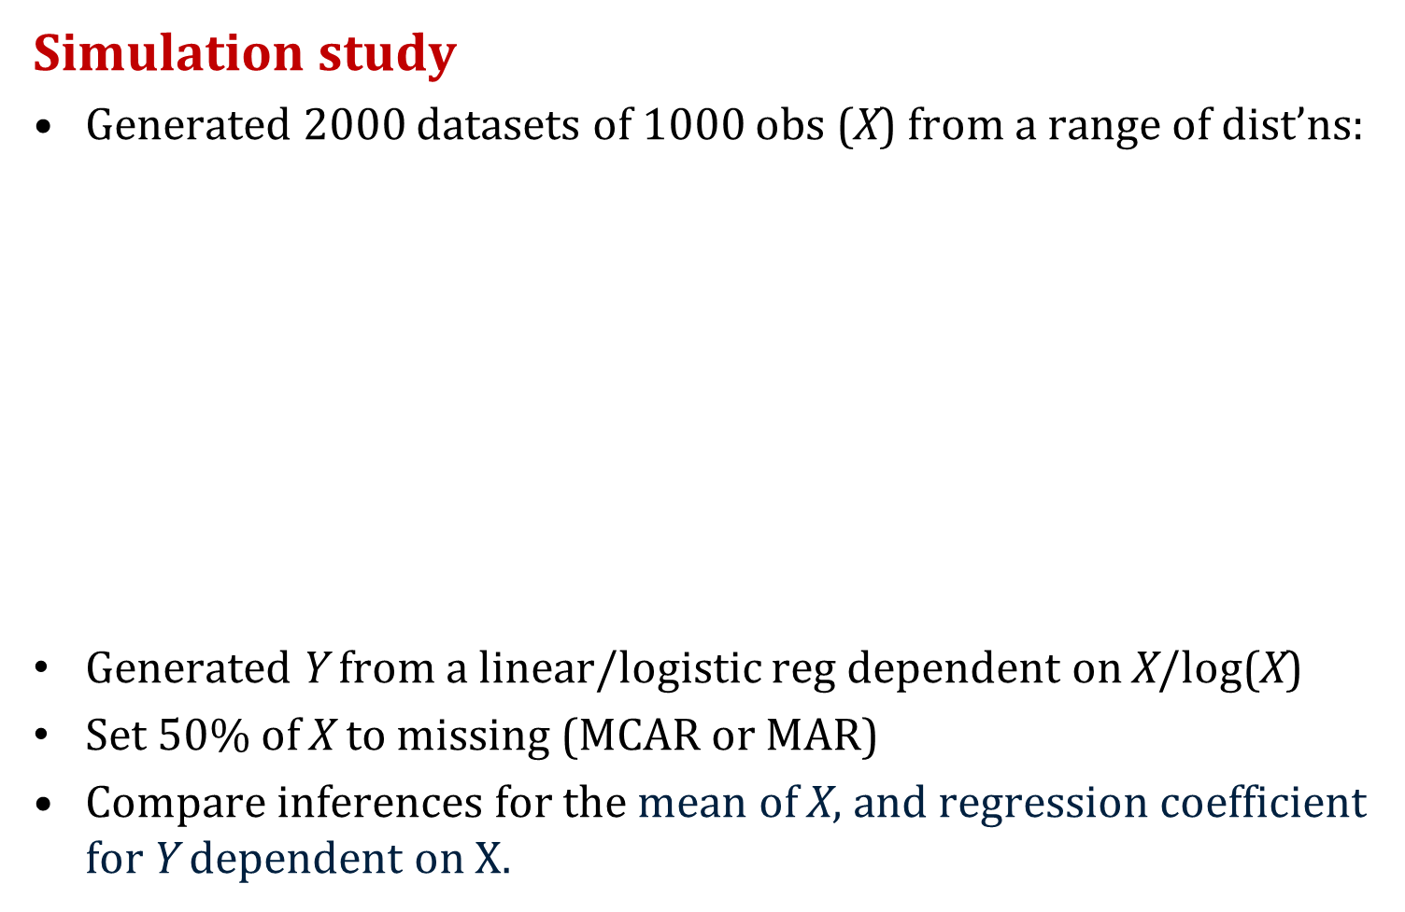
2. How to impute non-normal variables?
Simulation study
Generated 2000 datasets of 1000 obs (X) from a range of dist’ns:
Generated Y from a linear/logistic reg dependent on X/log(X)
Set 50% of X to missing (MCAR or MAR)
Compare inferences for the mean of X, and regression coefficient for Y dependent on X$.$
GH distributions*
Gamma distributions
Mixture of normal distributions†
Log-normal distributions
Notes:
Including positive skewed, negative skewed, bimodal and normal

Slide 23
2. How to impute non-normal variables?
Results – Y continuous related to X: mean of X
Raw
.02
.01
0
-.01
-.02
Normal
gh(0.5, 0)
mix(1, 1)
gh(-0.2, 0)
mix(1, 1.5)
gamma(2, 2)
mix(1.5, 1)
gamma(9, 0.5)
lognormal(0, 0.25)
lognormal(0, 0.0625)
Notes:
Figure showing bias in the marginal mean
Across the bottom we have the various distributions of X - normal first and then various non-normal transformations.
Bias on the y-axis.
What we really want to see is very low values i.e. small bias across all of these distributions which means the method is doing well irrespsecitve of the distribution of the data
-> this is looking good.

Slide 24
2. How to impute non-normal variables?
Results – Y continuous related to X: mean of X
Notes:
Now add the others on
some bias for some introduced with the zero-skewness and BC transformation
Again some bias with NP when deciles but good with NP per obs

Slide 25
2. How to impute non-normal variables?
Results – Y continuous related to X: association
Notes:
i.e. regression of Y on X…
Again raw does well
Quite large biases with zero-skewness log and Box-Cox.
NP seems to have the opposite pattern to with mean of X, now doing reasonably well when deciles but not so good when NP per obs.

Slide 26
2. How to impute non-normal variables?
Results – Y continuous related to log(X): association
Notes:
Now Y dependent on log (X)
Haven’t shown the results for the marginal mean of X as this was generated the same way as the first example.
For beta:
Imputing on the raw scale introduces bias
less bias when we transform prior to imputation
NP looks best
Similar results for a binary outcome, and when data are MAR

Slide 27
2. How to impute non-normal variables?
Summary
Distribution of the incomplete variable is (kind of) irrelevant
More about linearising the relationship between the variables in the imputation model
If the relationship is linear, transforming can introduce bias irrespective of the transformation used
If the relationship if non-linear, it may important to transform to accurately capture the relationship
Ties in with the issue of compatibility between the imputation and analysis models (Bartlett et al, SMMR, 2014)
(Lee & Carlin, submitted, 2014)
Notes:
Want to linearise the relationship between the variable(s) being imputed and the other variables in the imputation model
whether or not to transform is more about ensuring that the relationship between the variables is linear
In this example between a single variable being imputed i.e. X, and the completely observed outcome Y
This ties in with the issue of compatibility
Two conditional models (in our case the imputation and analysis models) are said to be compatible if there exists a joint model for which the conditionals of the joint model are the same as the two conditional models of interest. For this to hold, the form of the relationship between the variables in the imputation and analysis models must be the same in the two models.
In the analysis model you want to model the correct relationship e.g. maybe between Y and log(X) – in this case need to relate log(X) to Y in the imputation model
i.e. make sure in the analysis model that you have the relationship right so should in the imputation model too

Slide 28
3. How to impute limited range variables?
Some variables have a restricted range of values
Expected range e.g. age, height,…
By definition e.g. a clinical scale,…
Imputing as a continuous variable can mean imputed values fall outside the legal range
Options for imputation:
Impute as usual and use illegal values
Impute as usual and use post-imputation rounding
Impute using truncated regression
Impute using predictive mean matching
Notes:
Values may fall outside the expected range - Does it matter? Remember the aim of MI is about valid inference, not just about replacing missing values.
PMM
replaces the missing value with the nearest observed value (or average of a number of observed values) based on the predicted mean from a linear regression model
because only values that have been observed are used for the imputation, the range and distribution of the variable is preserved

Slide 29
3. How to impute limited range variables?
Comparative study (Rodwell et al, BMC Res Meth, 2014)
Simulation study based on the VAHCS where missingness was (repeatedly) introduced in a completely observed limited range variable (n=714, 33% MCAR or MAR)
Estimation of the marginal mean of the GHQ and regression with a fully observed outcome
Compared results to “truth” from the complete data
General Health Questionnaire (GHQ) | Likert (weak skew) | C-GHQ (moderate skew) | Standard (severe skew)
Distribution, complete data
Possible range | 0 – 36 | 0 – 12 | 0 - 12
Notes:
General health questionnaire (Wave 8)
Made up of 12 items each with 4 responses
3 different ways of scoring which resulted in 3 different distributions of observed data
Outcome = whether person lived at home at wave 9 (binary)

Slide 30
Performance measures for the estimation of the marginal mean of the GHQ
* Figure courtesy of Laura Rodwell
Notes:
Left figure shows bias – difference between estimate and true value.
Right figure shows the coverage of the 95% CI i.e. the proportion of 95% CIs that contain the true value – should be about 95%...
Likert (weak skewing) – all methods minimal bias
As the skew of the distribution increases, we start to see the bias increasing for the post-imputation rounding and the truncated regression imputation methods.
Post-imputation rounding – more values imputed below zero, shifting of the mean up with those rounded to zero
Truncated regression – fit of the model to the data questionable
Results not so striking for association – all methods provide an unbiased estimate with coverage around 95%.

Slide 31
3. How to impute limited range variables?
Techniques that restrict the range of values can bias estimates of the marginal mean of the incomplete variable, particularly when data are highly skewed
All methods produced similar estimates of association with a completely observed outcome
Best to impute using standard method and use illegal values (or use predictive mean matching)
Notes:
General health questionnaire (Wave 8)
Made up of 12 items each with 4 responses
3 different ways of scoring which resulted in 3 different distributions of observed data
Outcome = whether person lived at home at wave 9 (binary)

Slide 32
4. How to impute semi-continuous variables?
E.g. alcohol consumption in the VAHCS
number of zeros for non-drinkers
a positive range of values for drinkers
Options for imputation (when categorised for analysis)
Ordinal logistic regression (MICE)
Impute as continuous then round (MVNI)
Impute using indicators then round (MVNI)
Two-part imputation (MICE)
Predictive mean matching (MICE)
Notes:
Not clear which method is best
Two-part
First uses a logistic regression model to impute a binary variable for whether or not the individual drinks
Then uses a linear regression model to impute the (usually log-transformed) continuous component for those who drink
Because of the conditional nature of this approach, this method can only be applied within the MICE framework

Slide 33
4. How to impute semi-continuous variables?
Comparative study (Rodwell et al, submitted, 2014)
Simulated data based on the VAHCS
2000 datasets of 1000 observations
4 variables (semi-continuous exposure, binary outcome, confounder, auxiliary variable)
3 scenarios (25%, 50%, 75% zeros)
Semi-continuous variable MCAR or MAR (30% missingness)
Quantities of interest: Marginal proportions and log odds ratios: logistic regression for the binary outcome on the semi-continuous variable, adjusted for the confounder
Notes:
4 variables - semi-continuous alcohol variable, a binary outcome variable, a continuous confounding variable and a continuous auxiliary variable
3 scenarios – 25%, 50% and 75% of zeros
MAR – dependent on outcome, confounder and auxiliary
Imputation carried out using the 5 different methods

Slide 34
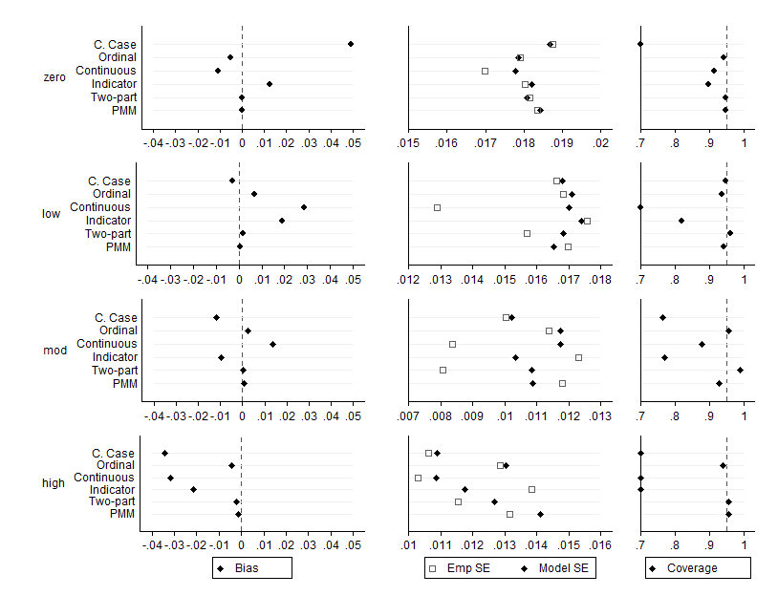
Results for the marginal proportions
(50% zero, MAR)
* Figure courtesy of Laura Rodwell
Notes:
Just focus on one scenario i.e. 50% zero, MAR – similar results for the other scenarios
Results are the estimates of the proportion in each category – focus on the high alcohol consumption category where the results are the most variable
Biases jump around a bit.
Imputing as continuous and rounding or as indicators and then round seem to have the largest bias
Little bias when impute using ordinal logistic or using two-part and PMM i.e. where no rounding is required
Two-part and PMM seem to be the best
Similar pattern for the coverage

Slide 35
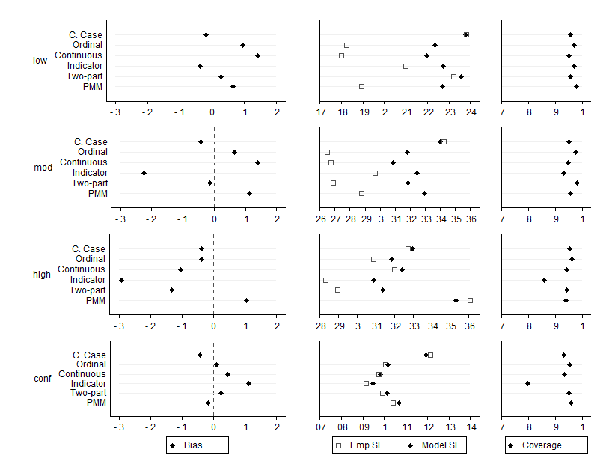
Results for the log odds ratios
(50% zero, MAR)
* Figure courtesy of Laura Rodwell
Notes:
Less clear cut for the association
Continuous and indicator that need rounding still the most extreme biases.
Others vary a bit
Coverage generally ok except for with the indicator method

Slide 36
4. How to impute semi-continuous variables?
Methods that require rounding after imputation should not be used
Recommend predictive mean matching or two-part imputation
Notes:
4 variables - semi-continuous alcohol variable, a binary outcome variable, a continuous confounding variable and a continuous auxiliary variable
3 scenarios – 25%, 50% and 75% of zeros
MAR – dependent on outcome, confounder and auxiliary

Slide 37
Future work
5. How to impute composite variables?
Variables derived from other variables in the dataset
Imputation can be carried out on either the composite variable itself, which is often the variable of interest, or the components
6. How to select auxiliary variables?
Current approaches often breakdown if there are a large number of incomplete variables
What causes models to break down?
Is it detrimental to include large numbers of auxiliary variables?
How correlated does a variable need to be to provide useful information?

Slide 38
Future work
7. How to apply MI in large-scale, longitudinal studies?
Standard MI approaches often cannot handle the large number of potential auxiliary variables and ignores the temporal association between repeated measures
Two-fold algorithm (Welsh, Stata Journal, 2014)
MI using a generalised linear mixed model – PAN (Schafer, Technical Report, 1997)
????
Notes:
Follows on from the previous question…
Not just about selection of variables, but need to develop new approaches to MI that make the most of the longitudinal nature of the data.

Slide 39
Summary
MI is a useful method for handling missing data:
Can reduce bias and improve efficiency compared with complete case analysis when data are MAR
… however it is not a miracle cure
Usefulness depends on the research question
Can introduce bias if the imputation model is not appropriate
Not always clear how best to apply MI
Current approaches are limited in their applicability to large-scale, longitudinal studies
Software tools for diagnostic checking are not available
What if data are MNAR?
Stay tuned….

Slide 40
References
Bartlett JW, Seaman SR, White IR, Carpenter JR, for the Alzheimer's Disease Neuroimaging Initiative. Multiple imputation of covariates by fully conditional specification: accommodating the substantive model. Statistical Methods in Medical Research 2014; 24(4):462-87.
Karahalios A, Baglietto L, Carlin JB, English DR, Simpson JA. A review of the reporting and handling of missing data in cohort studies with repeated assessment of exposure measures. BMC Medical Research Methodology 2012; 12: 96.
Lee KJ, Carlin JB. Multiple imputation for missing data: fully conditional specification versus multivariate normal imputation. Am J Epidemiol 2010; 171(5): 624-32.
Lee KJ, Carlin JB. Recovery of information from multiple imputation: a simulation study. Emerging themes in epidemiology 2012; 9(1): 3.
Lee KJ, Carlin JB. Multiple imputation in the presence of non-normal data. Submitted 2014.
Mackinnon A. The use and reporting of multiple imputation in medical research - a review. J Intern Med 2010; 268(6): 586-93.
Rodwell L, Lee KJ, Romaniuk H, Carlin JB. Comparison of methods for imputing limited-range variables: a simulation study. BMC Research Methodology 2014; 14: 57.
Rodwell L, Romaniuk H, Carlin JB, Lee KJ. Multiple imputation for missing alcohol consumption data. Submitted 2014.
Rezvan PH, Lee KJ, Simpson JA. The rise of multiple imputation: A review of the reporting and implementation of the method in medical research. BMC Research Methodology. 2015; 15: 30.
Rezvan PH, White IR, Lee KJ, Carlin JB, Simpson JA. Evaluation of a weighting approach for performing sensitivity analysis after multiple imputation. BMC Research Methodology. 2015; 15: 83.
Schafer JL. Imputation of missing covariates under a general linear mixed model. Dept. of Statistics, Penn State University, 1997.
Swift W, Coffey C, Degenhardt L, Carlin JB, Romaniuk H, Patton GC. Cannabis and progression to other substance use in young adults: findings from a 13-year prospective population-based study. J Epidemiol Community Health 2012; 66(7): e26.
Welch C, Bartlett J, Peterson I. Application of multiple imputation using the two-fold fully conditional specification algorithm in longitudinal clinical data. The Stata Journal 2014; 14(2): 418-31.
White IR, Carlin JB. Bias and efficiency of multiple imputation compared with complete-case analysis for missing covariate values. Statistics in Medicine 2010; 29(28): 2920-31.

Slide 41
Acknowledgements
Melbourne:
John Carlin
Julie Simpson
Cattram Nguyen
Laura Rodwell
Panteha Hayati Rezvan
Helena Romaniuk
Emily Karahalios
Jemisha Abajee
Margarita Moreno-Betancur
Alysha De Livera
George Patton (VAHCS)
Adelaide
Tom Sullivan
U.K. (Cambridge):
Ian White
NHMRC Project Grants (2005-07; 2010-12; 2016-18)
NHMRC CRE Grant (2012-16)
NHMRC CDF level 1 (2013-2016)

